Slide 1
🎾 Katoptron
AI‑Powered Forehand Technique Analyzer
Pose Comparison & AI Tennis Coaching Tool
Christos Kontomitros · January 2026

Slide 2
💡 Motivation / Problem
Amateur players want professional-level feedback
Hiring coaches is expensive and time-consuming
Existing apps are costly or not tennis-specific
Goal: Affordable AI-driven forehand analysis

Slide 3
⚡ User Journey
Upload professional reference video
Upload personal forehand video
AI aligns motions using MediaPipe + DTW
Receive visual & AI-generated coaching feedback

Slide 4
🏗️ High-Level Architecture
Browser → Django Backend
Celery async processing
MediaPipe pose extraction
DTW alignment & GPT-4o analysis
Results returned as video & report

Slide 5
🛠️ Technology Stack
Backend: Django 6.0, Redis, Celery
AI / Vision: MediaPipe, OpenCV, tslearn
LLM: GPT-4o structured outputs
Frontend: Bootstrap 5 + custom CSS

Slide 6
🔄 AI Pipeline
Pose extraction: 33 3D landmarks
Coordinate normalization
Dynamic Time Warping alignment
LLM converts data to coaching insights

Slide 7
🚀 AI Tennis Brain
Phase-specific technique analysis
Early injury risk detection
Human-readable coaching feedback

Slide 8
📊 Results
DTW Similarity Score: 8.92
Average joint angle difference: 17.4°
Top faults: elbow, shoulder, knee

Slide 9
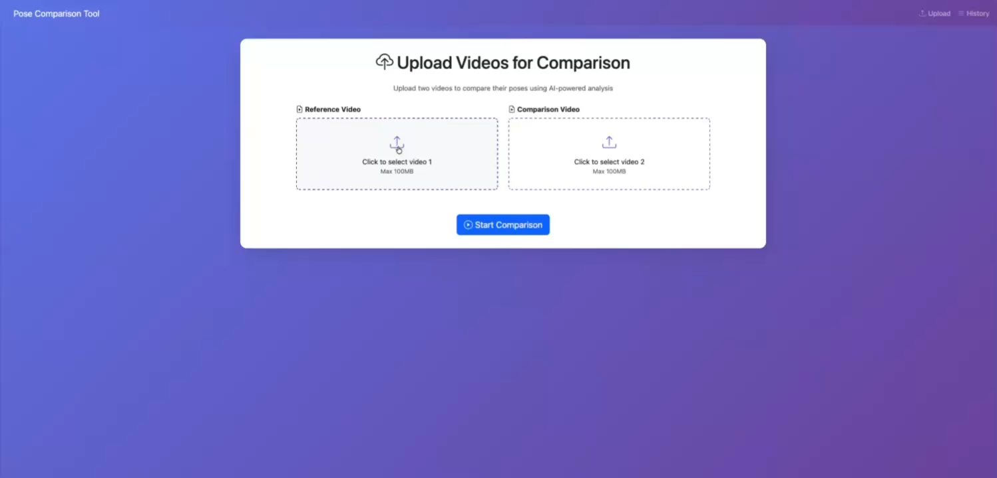
DEMO

Slide 10
⚠️ Challenges & Solutions
Slow processing → Celery async tasks
Video codec issues → FFmpeg transcoding
Camera perspective bias → 3D normalization

Slide 11
🔮 Future Roadmap
Backhand support
Mobile app
Racket tracking (YOLO)
Multi-angle analysis

Slide 12
💡 Lessons Learned
Structured LLM output beats free text
UX depends on background task visibility
Simple algorithms can outperform complex models

Slide 13
Thank You!
Questions?
Katoptron · 2026

